Slide 1

Dynamic Programing

Slide 2
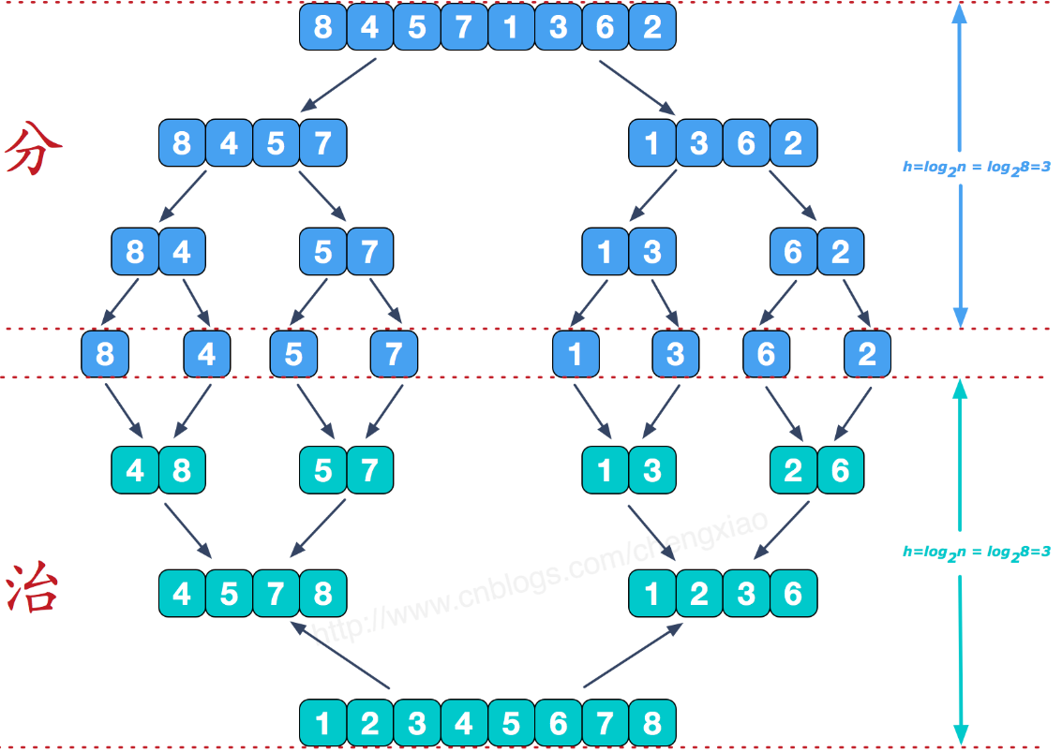
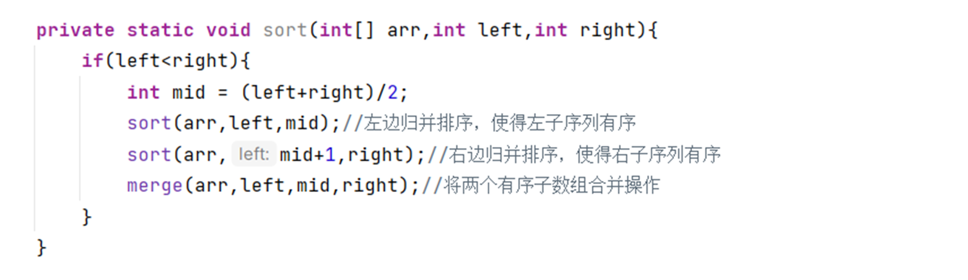
Merge Sort
Original Problem
Base Case
Repeatedly merge sublists to produce new sorted sublists until there is only one sublist remaining. This will be the sorted list.

Slide 3
Merge Sort Array(0,n)
Original Problem: sort(0,n)
Sub Problems : sort(i, j)
Recurrence Relation: sort(i,j)= merge(sort(i,m), sort(m+1,j))
Base Case s(i,i)

Slide 4
Longest Common Subsequence
Given two strings text1 and text2, return the length of their longest common subsequence. If there is no common subsequence, return 0
“ace” is a subsequence of ”abcde”

Slide 5
Word1=“abcde” Word2=“ace”
Brute Force: O(2^n)
How to define Sub Problem?

Slide 6
Subproblem Design
If input is Sequence List || Array || String
Prefixes [ : i]
Suffixes [i : ]
Sub String [i:j]
If input is multiple sequence
Prefixes A * Prefixes B * Prefixes C
Suffixes A * Suffixes B * Suffixes C
Sub String A * Sub String B * Sub String C

Slide 7
LCS Length | a | ac | ace
a | 1 | 1 | 1
ab | 1 | 1 | 1
abc | 1 | 2 | 2
abcd | 1 | 2 | 2
abcde | 1 | 2 | 3
prefix : [0:i]
Original Problem:
Sub Problem：
Base Problem:
LCS[Word1,Word2] => LCS[[0:L1], [0：L2]] =>LCS[L1 , L2]
L1=word1.length-1 L2=word2.length-1
LCS[i, j] i∈[0, L1] j∈[0,L2]
Word1.length =0 LCS[Word1, Word2] = 0
When Common Sub Sequence length ++?

Slide 8

Word1=“abcde” Word2=“ace”
Case 1: if(w1[i] == w2[j]) => LCS[i, j] = LCS[i-1,j-1]+1
Case 2: if(w1[i] != w2[j]) => LCS[i, j] = Math.max(LCS[i-1,j],LCS[i,j-1])
LCS Length | a | ac | ace
a | 1 | 1 | 1
ab | 1 | 1 | 1
abc | 1 | 2 | 2
abcd | 1 | 2 | 2
abcde | 1 | 2 | 3

Slide 9
DP feature 1 -最优子结构
An optimal solution to a problem contains optimal solutions to subproblems
一个问题的最优解， 一定包含其子问题的最优解
Word1=“abcde” Word2=“ace” “ace” 是LCS 那么 a || ac 一定也是其子问题的最优解

Slide 10
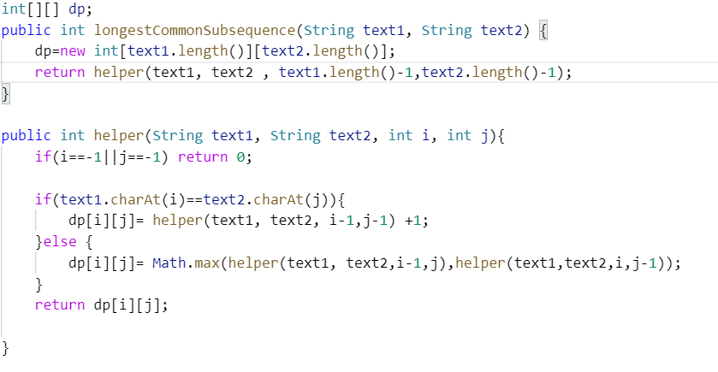
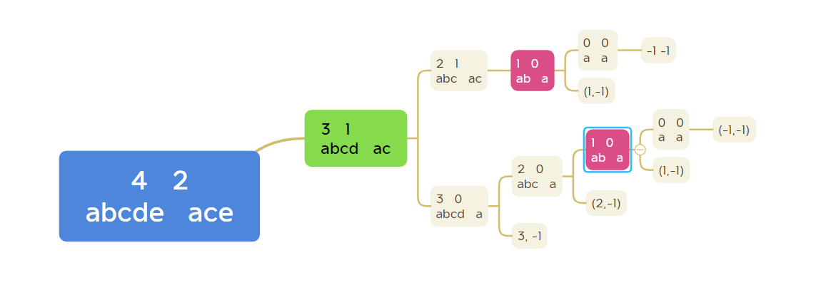
Word1=“abcde” Word2=“ace”
DP feature 2 -Overlapping Subproblem [Memoization]

Slide 11
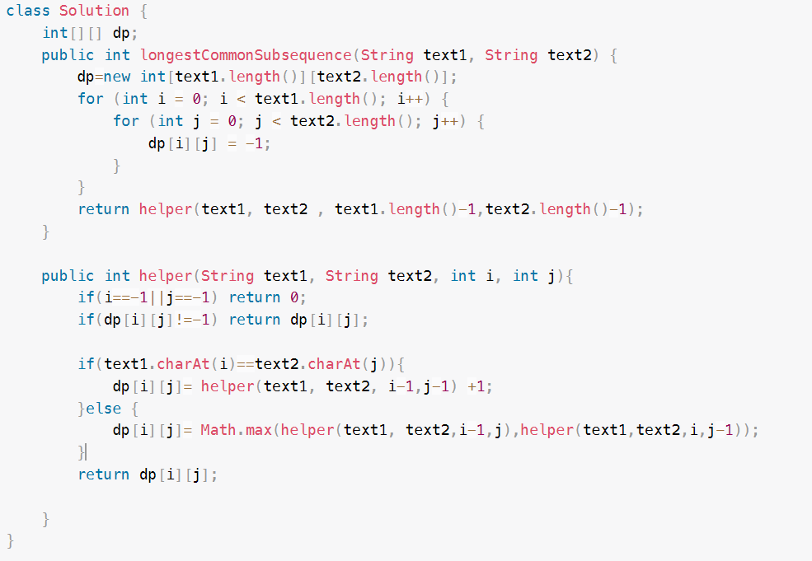
LCS TOP- Botton

Slide 12
小结
动态规划的两个特征--- 最优子结构 + 重叠子问题
子问题的设计---前缀，后缀，子串， 组合 etc.
状态转移方程
base case
DP=Recursion + Memoization

Slide 13
Thanks

